Slide 1
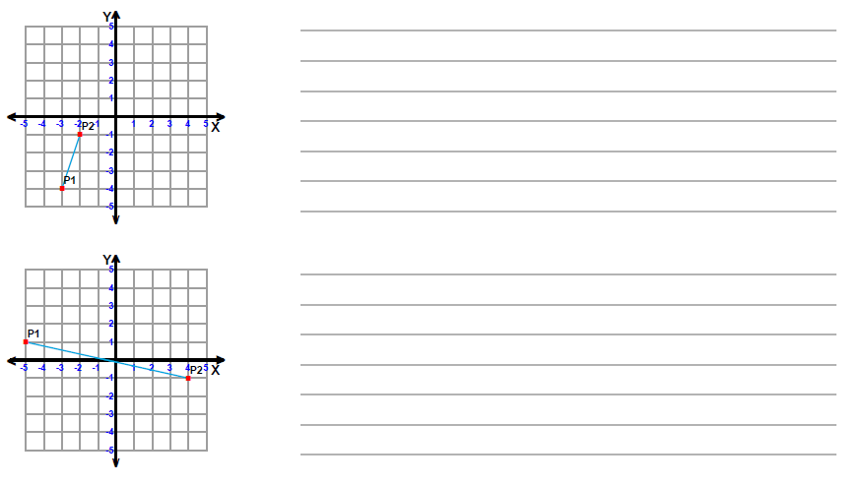
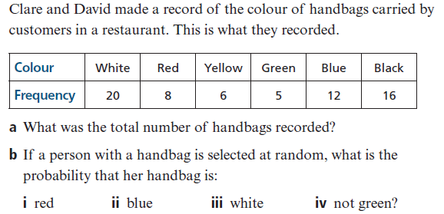
Find the Midpoint of the line
Probability
What is the sample space for year groups at a high school?
A bag of mixed chocolates contains pieces of dark chocolate, milk chocolate, white chocolate and “marbled chocolate”. Write the sample space?
3

Slide 2
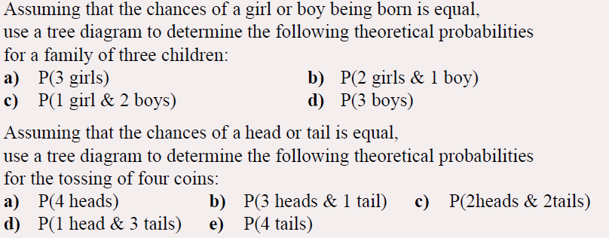
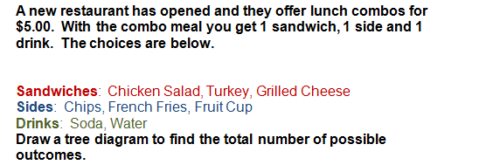
1
2

Slide 3
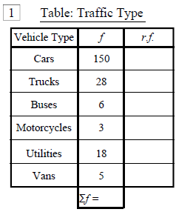
To determine the probability that anyone may have a particular type of car, Robbo did an experiment and measured the cars that went down a local street.
Calculate the relative frequency for each car type and complete the table above.
What is the relative frequency that a vehicle is a car or a ute?
What is the relative frequency that a car is a truck or a bus?
Using this data, can you work out how many of each car type you would have, if there were 10,000 vehicles?

Slide 4
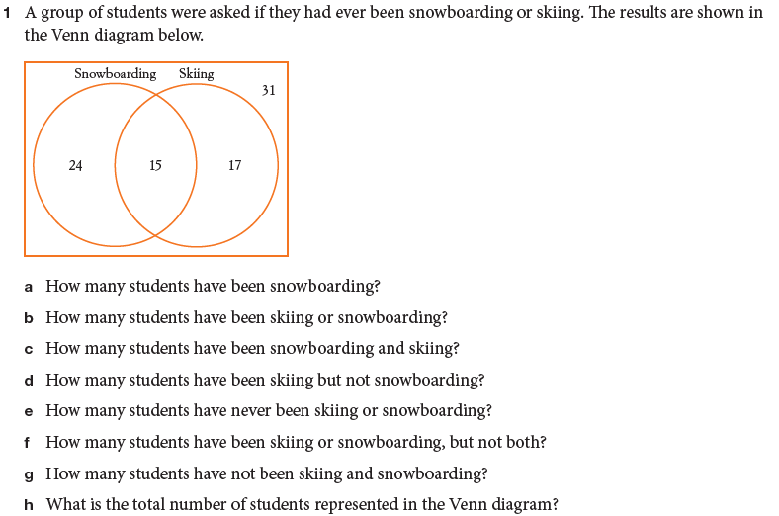
A bag has 10 balls in it. 3 Yellow, 3 green, 3 blue and 1 red. If 4 people take a ball out of a hat, and replace it, calculate the chance that for each of them to get the red ball.
Now assume the person keeps the ball they removed from the bag.
What is the chance the second person gets the red ball if the first person didn’t.
What is the chance the third person gets the red ball if the first and second person didn’t
What is the chance the third person gets the red ball if the first three people didn’t

